Slide 1
Multiscale Modelling of Materials Using Machine Learning
Team 3: Ujjwal Raj, Suraj Kumar, Janani KS, Prashant Tyagi
Indian Institute of Information Technology, Design and Manufacturing, Kancheepuram
Team 3: Ujjwal Raj, Suraj Kumar, Janani K Multiscale Modelling of Materials Using Mac
hine

Slide 2
Project Goal
Goal: Optimize grain size in copper heat pipes for enhanced thermal efficiency and stress management.
Team 3: Ujjwal Raj, Suraj Kumar, Janani K Multiscale Modelling of Materials Using Mac
hine

Slide 3
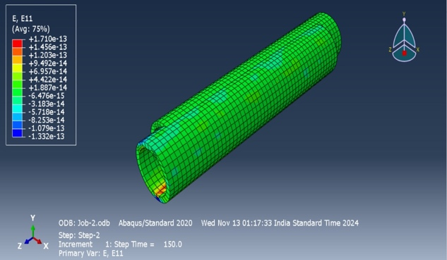
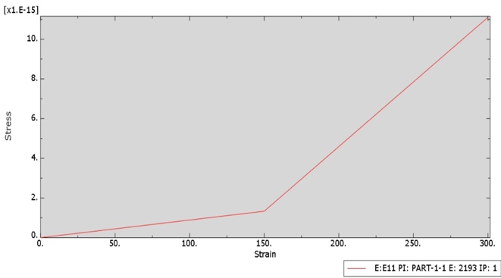
Component Scale Simulation using FEM
Model Setup: Copper pipe (8 mm ID, 10 mm OD, 100 mm length)
Material Properties:
Young’s Modulus: 110 GPa Poisson’s Ratio: 0.33
Yield Stress: 285 Mpa
Loading: Radial load of 200 units, no fixed ends
Objective: Evaluate stress, displacement, and strain
Team 3: Ujjwal Raj, Suraj Kumar, Janani K Multiscale Modelling of Materials Using Mac
hine

Slide 4
Importance of Microstructure
Need for Microstructure: Grain size and dislocation density affect material strength, heat transfer, and durability.
Simulation of Grain Size: Tested grain sizes from 5 – 95 microns across strain rates (10⁻² to 10⁻⁵).
Impact on Heat Pipe Efficiency: Smaller grains withstand higher stress, improving performance.
Team 3: Ujjwal Raj, Suraj Kumar, Janani K Multiscale Modelling of Materials Using Mac
hine

Slide 5
Multiscale Modeling Strategy
Purpose: Link microstructure properties (grain size, orientation) to macroscale FEM.
Integration: Polynomial regression model incorporates grain size effects.
Benefit: Better predictions of stress and deformation in the heat pipe.
Team 3: Ujjwal Raj, Suraj Kumar, Janani K Multiscale Modelling of Materials Using Mac
hine

Slide 6
VPSC Model Setup and Microstructure Integration
VPSC Model Configuration:
Adjusted strain rate in tension.1 Modified grain size in copper.sx
Microstructure Representation: Grain size and orientation affect plastic deformation and stress distribution.
Team 3: Ujjwal Raj, Suraj Kumar, Janani K Multiscale Modelling of Materials Using Mac
hine

Slide 7
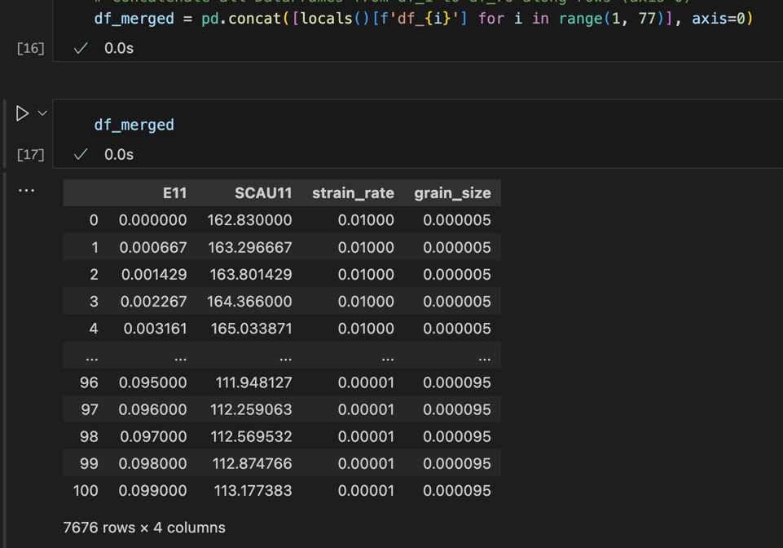
Database Generation as a Function of Strain Rate and Microstructure
Process: 76 simulations with varying strain rates (10² to 10) and grain sizes (5–95 microns) were performed.
Utility for ML: Enables ML model to predict how grain size and strain rate influence material behavior.
Team 3: Ujjwal Raj, Suraj Kumar, Janani K Multiscale Modelling of Materials Using Mac
hine

Slide 8
Development of Constitutive Model Using ML
Dataset Preparation: Combined and split data (80% training, 20% testing).
Model Training: Polynomial regression (degree 2) for stress as a function of strain, strain rate, and grain size.
Equation Development : After training, we plotted the stress-strain relationship and derived the coefficients and intercepts. The final constitutive equation based on the polynomial regression is as follows:
Stress (SCAU11) = 115.87000 + (581.17094) * E11 + (24694.12860) * strain_rate + (-1168663.06000) * grain_size + (-1368.07412) * E11^2 + (12543.13140) * E11 * strain_rate + (-29095.13080) * E11 * grain_size + (-2102507.11000) * strain_rate^2 + (-9820971.89000) * strain_rate * grain_size + (8222685370.00000) * grain_size^2
This equation represents the relationship between the stress, strain, strain rate, and grain size in the copper heat pipe and can be used for further simulations and predictions of material behavior under different loading conditions.
Team 3: Ujjwal Raj, Suraj Kumar, Janani K Multiscale Modelling of Materials Using Mac
hine

Slide 9
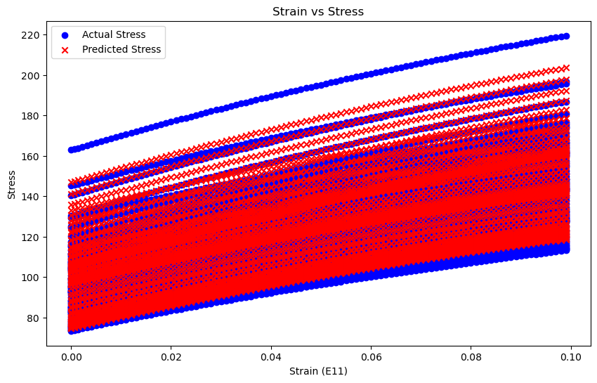
Development of Constitutive Model Using ML
Machine Learning Evaluation
Mean Squared Error: 31.44034706052648
R-squared: 0.9485657844102036
Team 3: Ujjwal Raj, Suraj Kumar, Janani K Multiscale Modelling of Materials Using Mac
hine

Slide 10
UMAT Code and ML-Derived Constitutive Law Integration
1. Stress Flow Equation Integration in UMAT:
We integrated the machine learning-derived stress equation in the UMAT code by defining it as the sf variable.
2. Incorporating Plastic Deformation Behaviour:
To account for plastic deformation, we differentiated the stress equation with respect to eqplas (plastic strain) and updated sf and et by adding dequal, representing accumulated plastic strain.
3. Dynamic Stress-Strain Adjustment:
The ML-derived equation, implemented in the UMAT subroutine for isotropic strain hardening, adjusts the stress-strain relationship at each simulation step based on local grain size and strain rate.
4. Accounting for Microstructure Variability:
This approach captures the effects of microstructure heterogeneities, providing a more accurate response than models that assume uniform material properties.
Team 3: Ujjwal Raj, Suraj Kumar, Janani K Multiscale Modelling of Materials Using Mac
hine

Slide 11
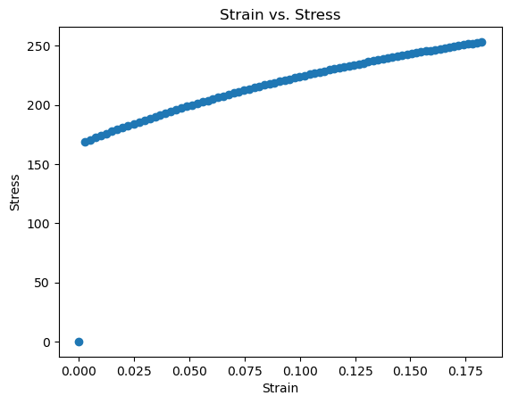
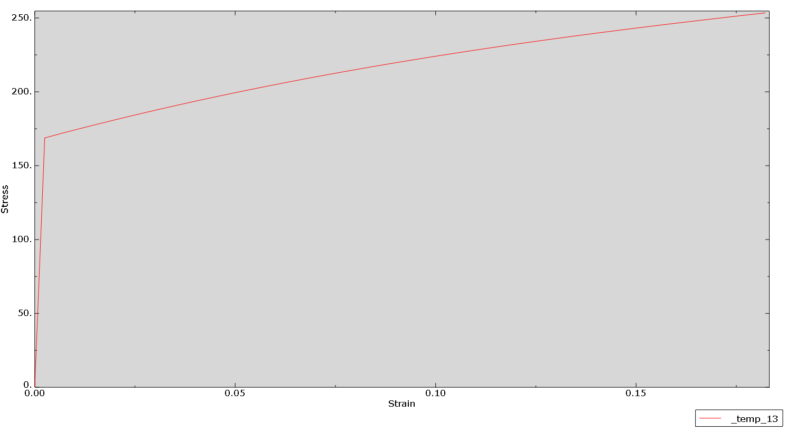
Validation of FE-UMAT Against VPSC Results
Method: Single-element FE simulation for grain size 65 microns, strain rate
10⁻².
Significance: Ensures UMAT model using the ML derived equation, predicts material behavior accurately.
Graph Comparison:
The graph below shows the stress-strain results from both UMAT and VPSC.
The close match between them confirms that the UMAT model is accurate.
VPSC Plot
ML Enhanced Umat Plot
Team 3: Ujjwal Raj, Suraj Kumar, Janani K Multiscale Modelling of Materials Using Mac
hine

Slide 12
FEM Model Geometry, Mesh, and Microstructure
Setup: Solid copper pipe with diameter 10mm and length 100mm, one end fixed, 200-unit tensile load applied.
Mesh Details: Square elements, edge length 2.
Microstructure in Models: VPSC uses uniform properties; ML-based model includes grain size variations.
Team 3: Ujjwal Raj, Suraj Kumar, Janani K Multiscale Modelling of Materials Using Mac
hine

Slide 13
Results and Discussion
With Microstructure: ML model shows strain localization, stress increases as grain size decreases.
Without Microstructure: VPSC model shows uniform response.
Impact: This comparison demonstrates that grain size significantly affects material behavior, providing deeper insights into how microstructure influences deformation and performance.
Team 3: Ujjwal Raj, Suraj Kumar, Janani K Multiscale Modelling of Materials Using Mac
hine

Slide 14
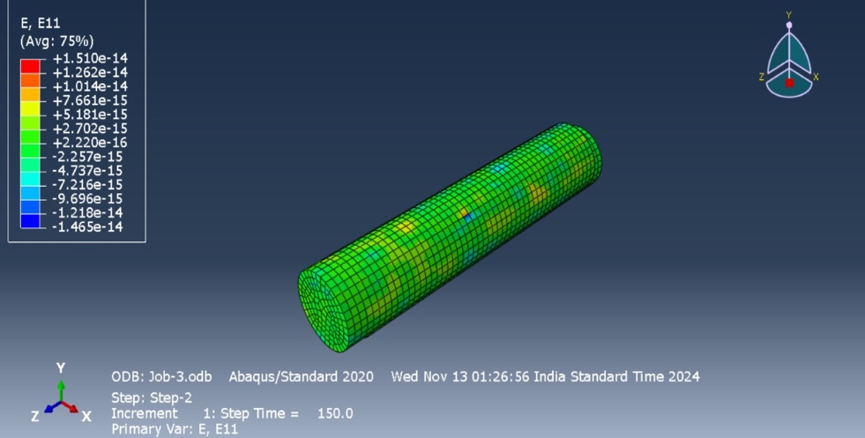
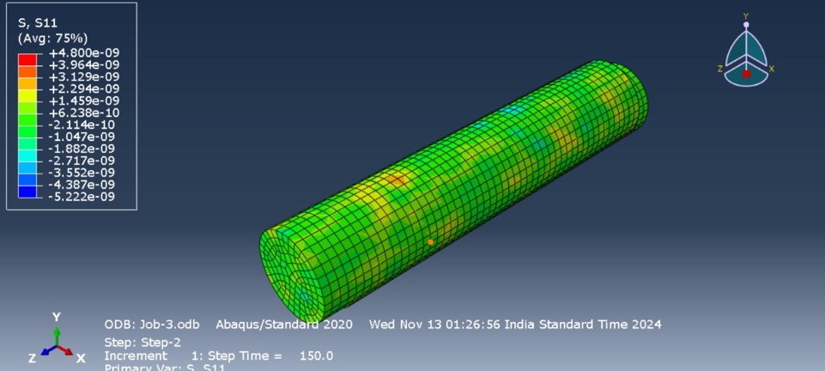
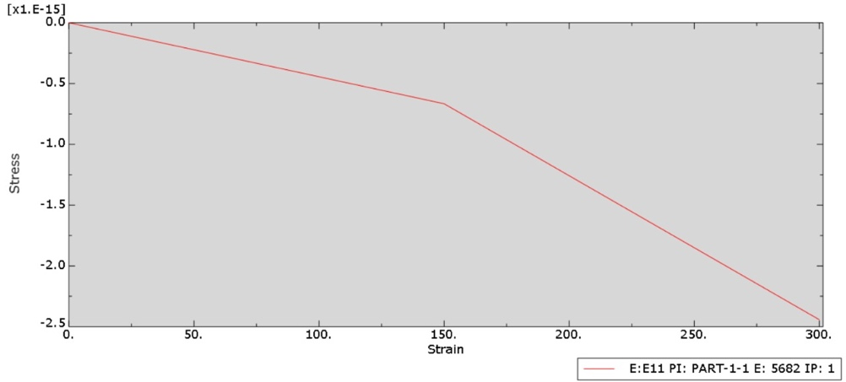
Results and Discussion
Results and Plots
1) Stress vs Strain Analysis when grain size is introduced
Strain Distribution
Stress Distribution
Stress vs Strain graph when
microstructure is included.
Team 3: Ujjwal Raj, Suraj Kumar, Janani K Multiscale Modelling of Materials Using Mac
hine

Slide 15
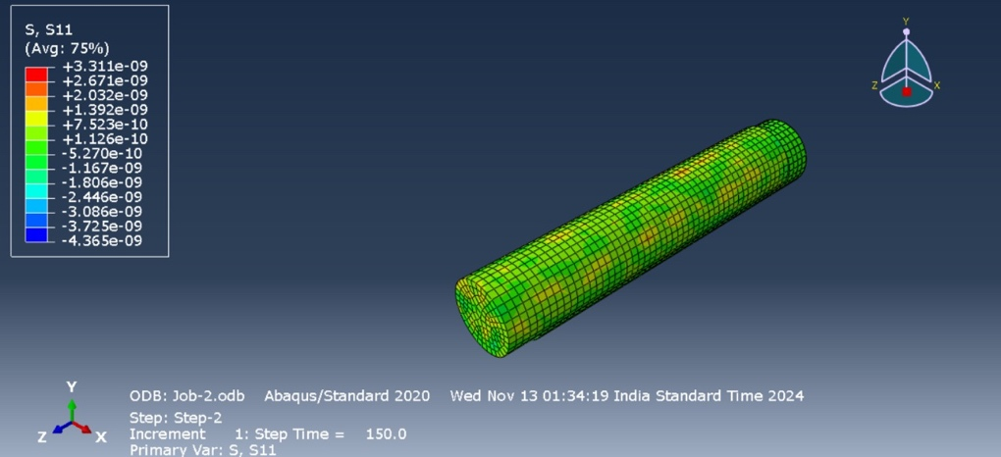
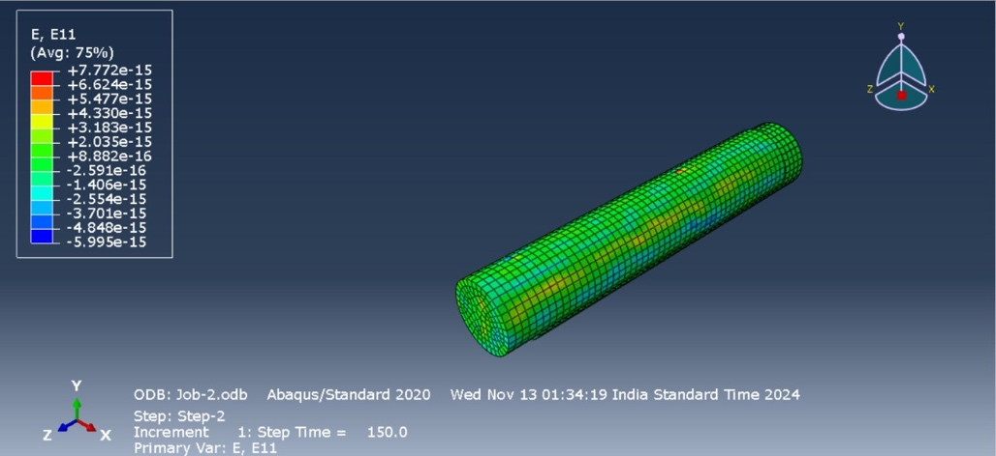
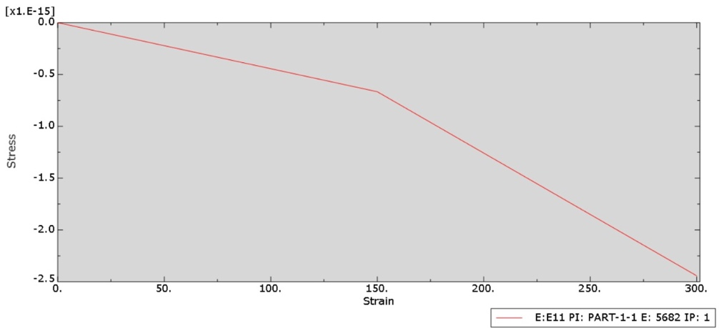
Results and Discussion
Results and Plots
1) Stress vs Strain Analysis when grain size is not introduced
Strain Distribution
Stress Distribution
Stress vs Strain graph when
microstructure is not included.
Team 3: Ujjwal Raj, Suraj Kumar, Janani K Multiscale Modelling of Materials Using Mac
hine

Slide 16
Conclusion
Key Findings: Microstructure, especially grain size, enhances strength and efficiency.
Optimal Grain Size: 10–20 microns for copper heat pipes, balancing strength and thermal conductivity.
Implications: Improved accuracy in material behavior prediction and heat pipe design.
Team 3: Ujjwal Raj, Suraj Kumar, Janani K Multiscale Modelling of Materials Using Mac
hine

